Slide 1
COLOUR THRESHOLDING BASED SEGMENTATION TECHNIQUE TO DETECT TUMORS IN MRI SCAN IMAGES
GUIDED BY:
MS.M.SHARMILA.,M.Tech(AP/IT)
PRESENTED BY:
S.MANIMEKALA(13BIT2039)
B.UMA MAHESWARI(13BIT2099)
R.VAISHNAVI(13BIT2101)

Slide 2
ABSTRACT
The Color Thresholding based segmentation technique is highly used for manipulating the color components of the images, based on different color spaces.
Image segmentation may be defined as a technique, which partitions a given image into a finite number of non overlapping regions with respect to some characteristics, such as gray value distribution, texture distribution, etc.

Slide 3
CONTD..,
The image segmentation is defined as an optimal segmentation obtained in a pure bottom-up fashion that provides the information necessary to initialize and constrain high level segmentation methods.
This method is effective in segmenting the complex background images, these results are used to propose a new color image segmentation method.

Slide 4
CONTD...,
It searches for the principal colors, defined as the intersections of the homogeneous blocks of the given image.
As such, rather than using the noisy individual pixels, which may contain many outliers, this method uses.The image segmentation is defined as an optimal segmentation obtained in a pure bottom-up fashion that provides the information necessary to initialize and constrain high level segmentation methods.

Slide 5
INTRODUCTION
Brain tumor is the collection or growth of abnormal cells in the brain.
Brain tumor is classified into two main types namely cancerous(Malignant) and non cancerous(Benign).
Benign is of less risk when compared to malignant tumor.
The common symptoms are headache, vomiting, blurred vision, difficulty in walking, etc.

Slide 6
EXISTING SYSTEM
Color segmentation of image is a crucial operation in image analysis and in many computer vision, image interpretation, and pattern recognition system, with applications in scientific and industrial fields such as medicine, Remote Sensing etc.,
The performance of color segmentation may significantly affect the quality of an image understanding system.

Slide 7
PROPOSED SYSTEM
The system contains the real examples of image quality improvement, distortion simulations, objective and subjective quality assessment and other ways of image processing that can be obtained by the individual applications.

Slide 8

SYSTEM ARCHITECTURE
To segment tumor regions from MRI image, here an efficient algorithm called Threshold segmentation algorithm is used.
It is performed by dividing the whole process into three stages such as Pre-processing stage, Segmentation stage and Output stage.

Slide 9
DESCRIPTION
Tumor is defined as the abnormal growth of the tissues. Brain tumor is an abnormal mass of tissue in which cells grow and multiply uncontrollably.
MRI scan images are used to detect those tumor cells.
Tumor segmentation in magnetic resonance imaging (MRI) has become an emergent research area in the field of medical imaging system.

Slide 10
SOFTWARE USED-MATLAB
MATLAB is a high-performance language for technical computing.
MATLAB is called as the matrix laboratory.
It is widely used in image processing and signal processing. It is the fourth generation language.
Many of the mathematical expression on an array are made or in-build in matlab. The basic of matlab is matrix. It is represented in terms of rows and columns.

Slide 11
EDGE DETECTION
Edge detection is a type of Image Segmentation Techniques which determines the presence of an edge or line in an image and outlines them in an appropriate way .
The edge is a set of those pixels whose grey have step change and rooftop change, and it exists between object and background, object and object, region and region, and between element and element.

Slide 12
SOBEL OPERATORS
Standard Sobel operators, for a 3×3 neighborhood, each simple central gradient estimate is vector sum of a pair of orthogonal vectors .
Each orthogonal vector is a directional derivative estimate multiplied by a unit vector specifying the derivative’s direction.
The vector sum of these simple gradient estimates amounts to a vector sum of the 8 directional derivative vectors.

Slide 13
IMAGE PROCESSING
Digital Image processing is an emerging field in which doctors and surgeons are getting different easy pathways for the analysis of complex disease such as cancer, brain tumor, breast cancer, kidney stones, etc.
In the diagnosis analysis of MRI images, segmentation of image is required and analysis of image segmentation is very important part of any type of detection in image analysis

Slide 14
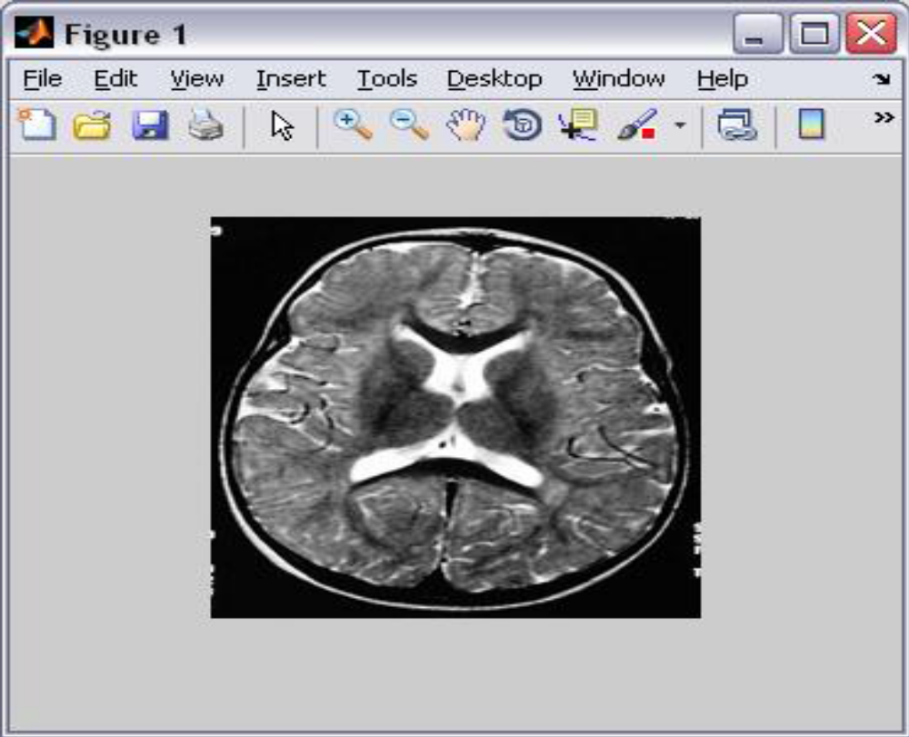
RESULT ANALYSIS
MRI brain image is given as input image. Since it contains RGB mixing in it, we cannot get a clear output image.

Slide 15
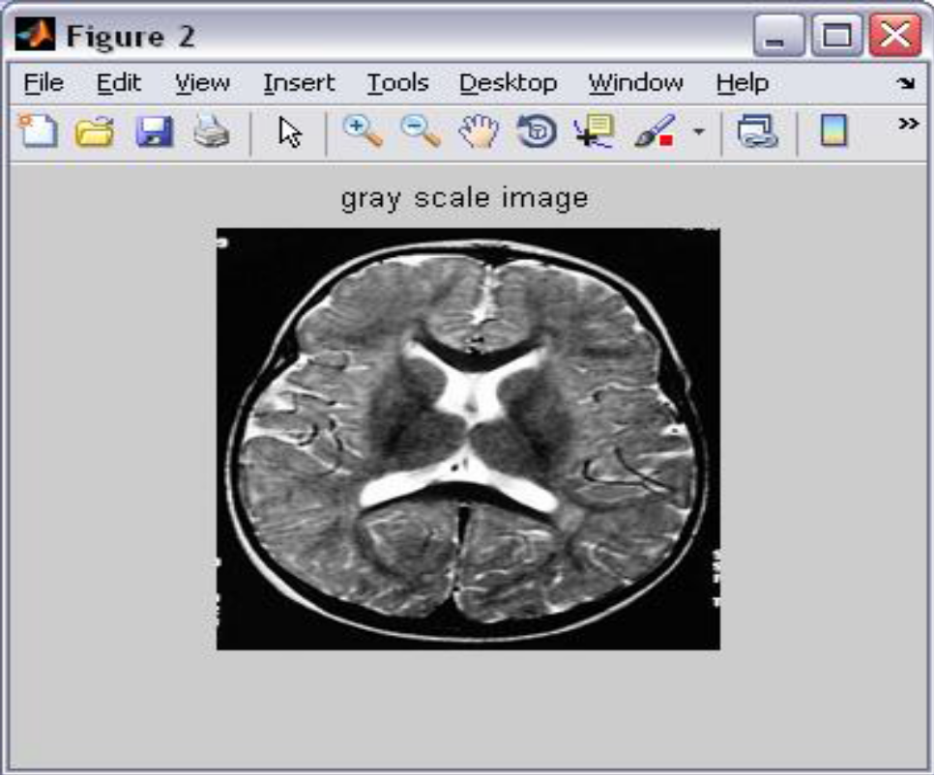
RGB REMOVED IMAGE
To remove RGB mixing from the input image, we convert it into grayscale image which is black and white image.

Slide 16
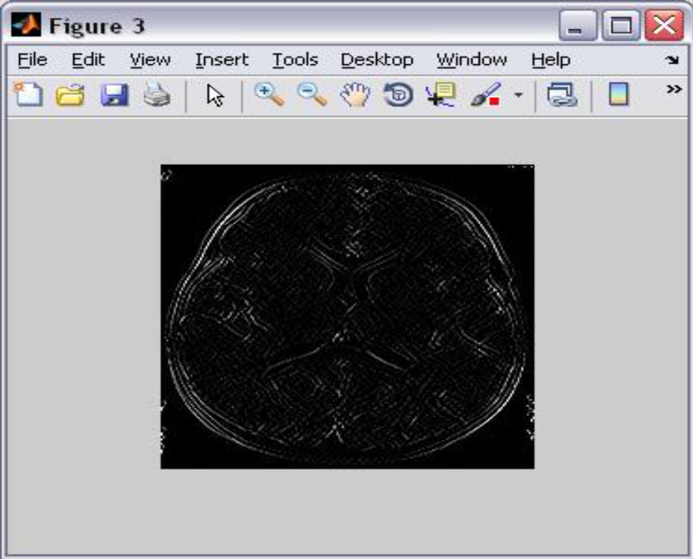
GRAY SCALE IMAGE
Gray scale converted image consists of noise.
To remove the noise and to enhance the image high pass filter is used.

Slide 17
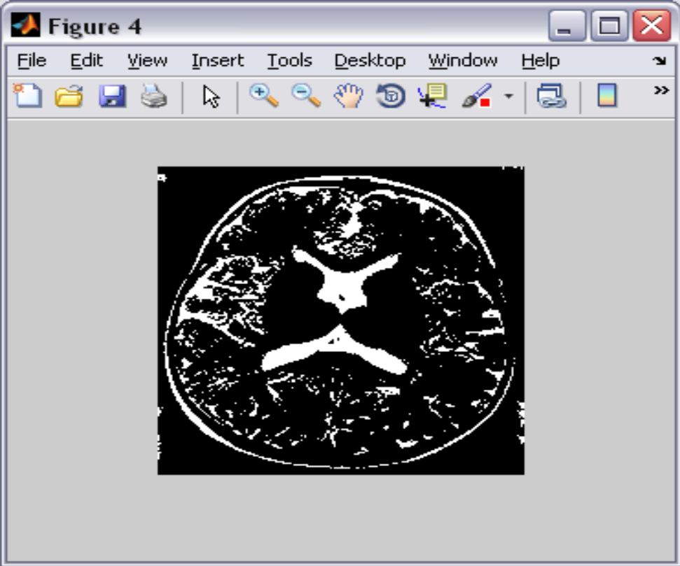
THRESHOLDED IMAGE
Threshold segmentation method is used to segment the tumor
regions from the input image.

Slide 18
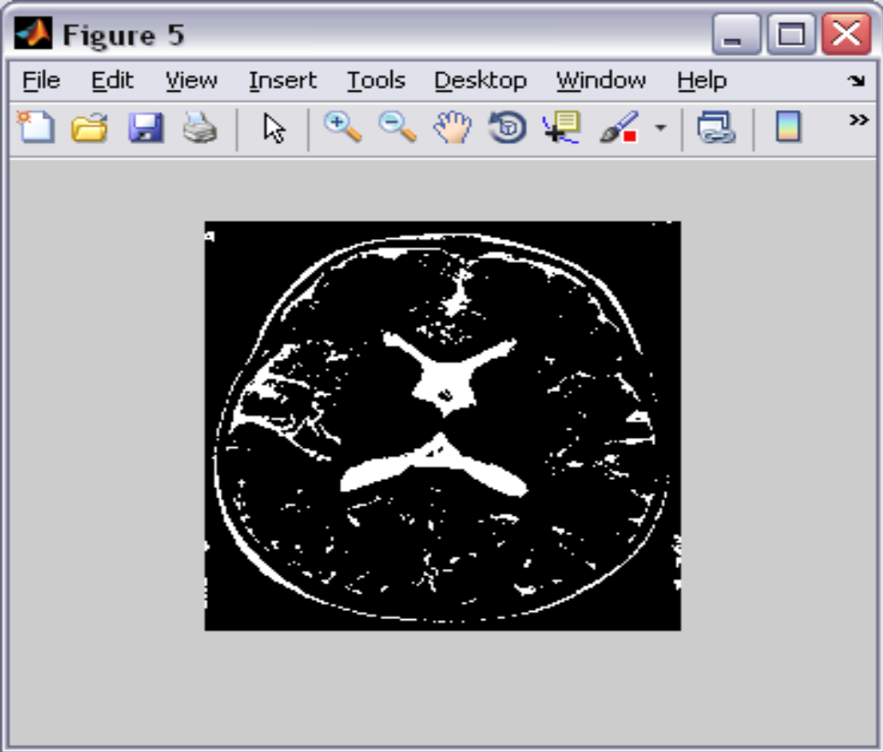
OUTPUT IMAGE
Output image shows only the tumor regions present in the MRI brain image.

Slide 19
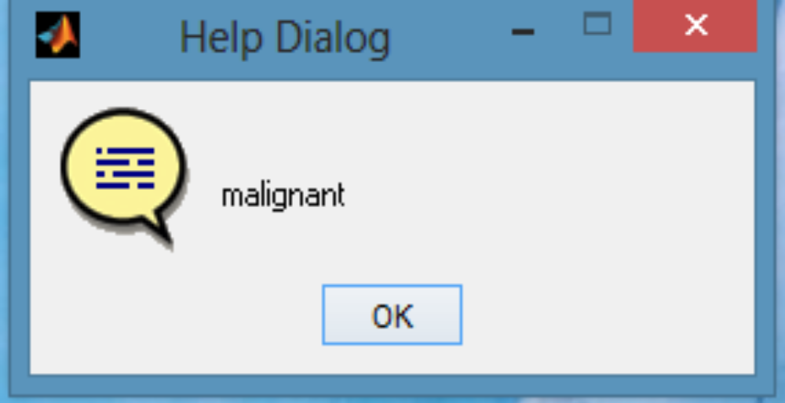
IDENTIFYING THE TYPE OF TUMOR
Using SVM classifier, the type of tumor is specified whether it is malignant, benign or normal.

Slide 20
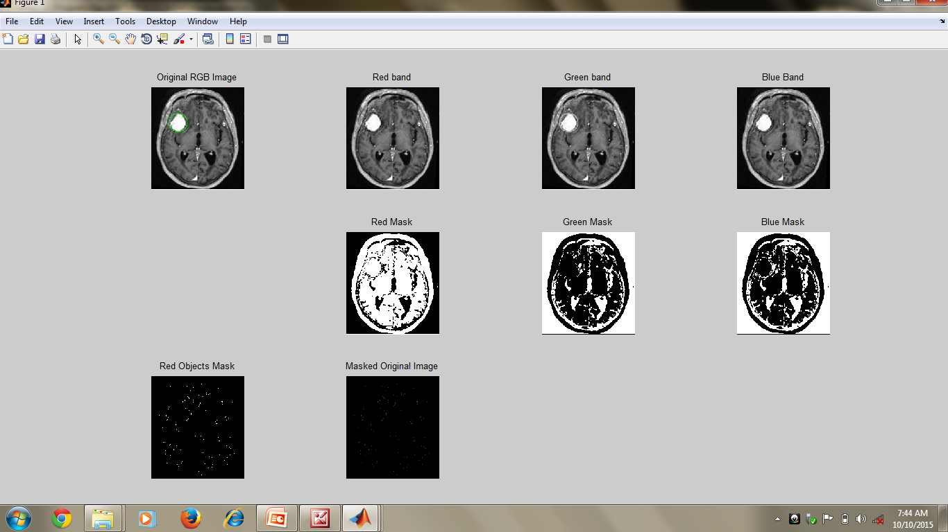
SCREEN SHOT

Slide 21
CONCLUSION
The tumor regions from the MRI brain image are segmented using threshold segmentation method and the type of brain tumor is specified using SVM classifier.
We have proposed an efficient classification system based on density-based clustering approach to detect the brain tumor.
The brain tumor detection is a great help for the physicians and a boon for the medical imaging and industries working on the production of CT Scan and MRI imaging.

Slide 22
FUTURE WORK
The future work could be aimed to extend the set of applications to cover even more areas of image and video processing.
Now people are currently working on development of new applications for quality assessment of video sequences and stereoscopic images.

Slide 23
REFERENCES
An Efficient Brain Tumor Detection Algorithm Using Watershed& Thresholding Based Segmentation, Anam Mustaqeem , I.J. Image, Graphics and Signal Processing, 2012, 10, 34-39 Published online September 2012 in MECS (http://www.mecs-press.org/) DOI: 10.5815/ijigsp.2012.10.05
Brain Tumor MRI image segmentation and detection in image processing, Rohini Paul Joseph, eISSN: 2319-1163 | pISSN: 2321-7308

Slide 24
CONTD...,
Brain tumor extraction from MRI images using MATLAB,Rajesh.C, International Journal of Electronics, Communication &Soft Computing Science and Engineering,ISSN: 2277-9477, Volume 2, Issue 1
Brain tumor detection and segmentation using histogram thresholding,Manoj K Kowar, International Journal of Engineering and Advanced Technology (IJEAT) ISSN: 2249 – 8958, Volume-1, Issue-4, April 2012

